Slide 1
StQW Neighbourhood Forum and St Helens Residents Association
Open Meeting
18th February 2016

Slide 2
Agenda for this evening
1. Update on local crime from PC Dan Beall
2. Referendum on the StQW Draft Plan on February 25th - update on the legal challenge
3. OPDC consultation on Local Plan for Old Oak and Park Royal - feedback from first few consultation sessions
4. Implications for our area of the Housing and Planning Bill
5. Residents parking in Pangbourne Avenue - impact of Argyll Place development
6. Any other business (new RBKC Construction Code)

Slide 3
StQW referendum
The electorate for this referendum has been worked out by RBKC as 2,282 electors
A 20% turnout would be 456 voters
Local election turnout in Dalgarno and St Helens was 34% at 2014 election
A simple majority ‘Yes’ vote is all that is needed for the StQW Draft Plan to be adopted
But with a legal challenge pending we need to maximise the turnout – remind your neighbours
Reminder emails and flyers. Posters on the day?

Slide 4
The legal challenge to the StQW Plan
A judicial review application from the Legards
Challenges the Council’s decision to advance the StQW Draft Plan to a referendum
Asks the High Court to quash this decision
‘Grounds’ for the challenge relate to the 3 criteria for Local Green Space designation
Claims that the examiner and Council did not give enough consideration to Criterion 1
Questions whether Nursery Lane ‘serves’ the
local community, given no public access.

Slide 5
Old Oak and Park Royal Local Plan
OPDC consultation sessions in progress
Not well attended
Discussion on boundaries of ‘places’ (e.g. Old Oak West’) and hard boundary between ‘strategic industry’ and residential zones
Risk of ‘fringe areas’ being forgotten
Cargiant have also consulted on their latest plans – see at www.oldoakpark.co.uk

Slide 6
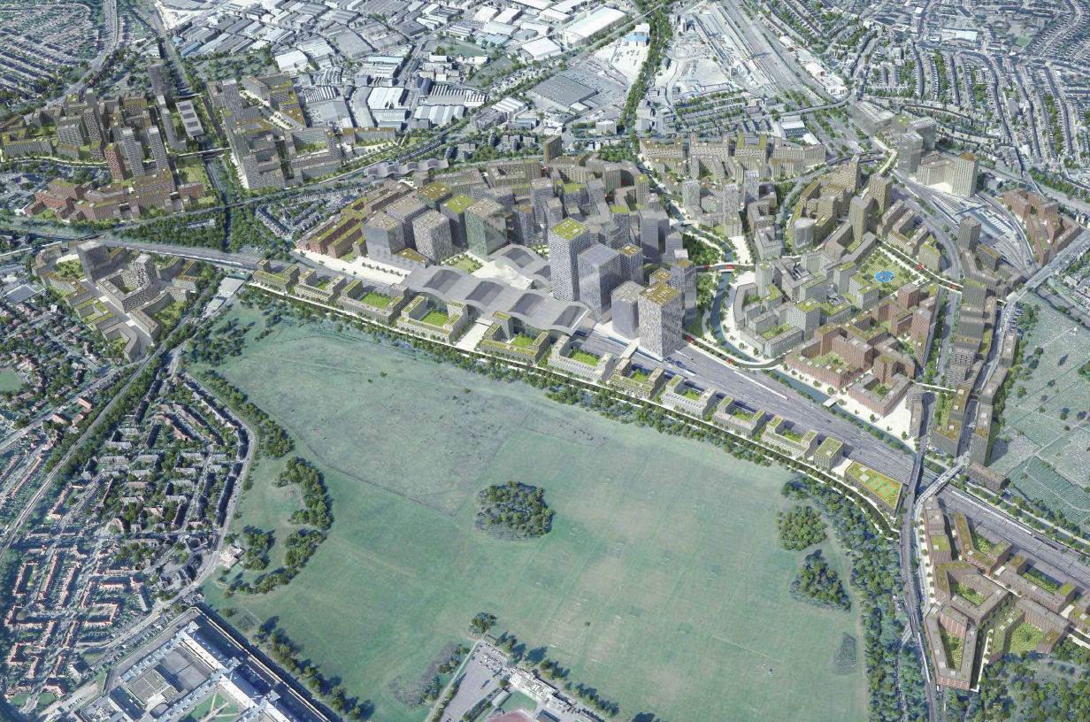
Image from OPDC Local Plan

Slide 7
Phasing of housing delivery

Slide 8
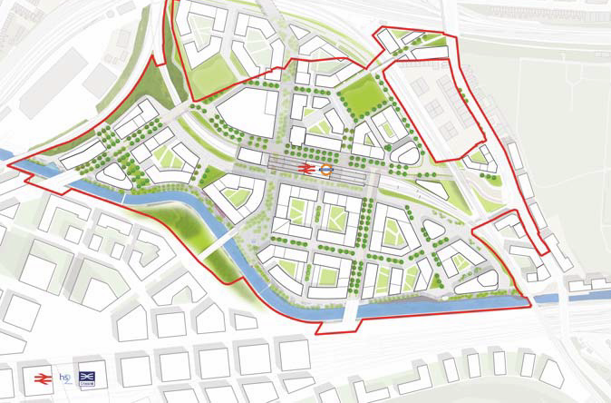
Car Giant masterplan

Slide 9
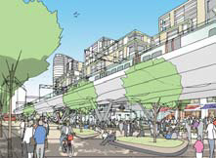
Proposed Central Square

Slide 10
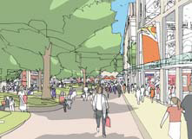
Proposed ‘Old Oak Walk’

Slide 11
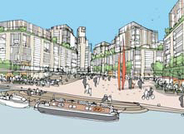
Proposed ‘Grand Union Square’

Slide 12
Housing and Planning Bill
LGA predicting ‘unforseen consequences’ from
extension of Right to Buy to Housing Assocs
20% discount on ‘starter homes’ at £450k
Pressure on private rented sector and higher Housing Benefit costs
forced sale of high value LA housing
Restrictions on LA tenancy strategies
Competition on processing planning applications

Slide 13
Pangbourne Avenue parking
RBKC has a policy that all new housing developments in the Borough should be ‘permit-free’.
There has been some confusion over whether this applied to Argyll Place.
There has been pressure on residents spaces in Pangbourne Avenue on recent months.

Slide 14
Extracts from RBKC Residents Parking Guide
You are not eligible for a permit, and any permit issued may be withdrawn, if:
• you live in a permit free development (except if you are applying for a motorcycle bay permit)
• if your circumstances change and you are no longer eligible for a residents permit, you must return the permit immediately. If you do not return your permit when you are no longer eligible for it, you will be committing an offence and may be prosecuted and /or be banned from reapplying

Slide 15
RBKC Construction Code
The Council has introduced a tougher Code on building works, from February 11th
Noisy working not allowed on Saturday mornings (other work still OK)
Council will enforce under 1974 Control of Pollution Act
020 7361 3002 - Environmental Healthline
environmentalhealth@rbkc.gov.uk

Slide 16
Remember to vote next Thursday
Polling station open 7am to 10pm
Remind friends and neighbours

